Slide 1


Sequential Matching Network: A New Architecture for Multi-turn Response Selection in Retrieval-Based Chatbots
Yu Wu
SKLSDE, Beihang University
wuyu@buaa.edu.cn
Wei Wu
Microsoft Research
wuwei@microsoft.com
Chen Xing
Nankai University
v-chxing@microsoft.com
Zhoujun Li
SKLSDE, Beihang University
lizj@buaa.edu.cn
Ming Zhou
Microsoft Research
mingzhou@microsoft.com

Slide 2
Outline
Task, challenge, idea, and contribution
Our approach
Sequential Matching Network
Experiment
Experiment setup: data sets and baseline methods
Evaluation and analysis

Slide 3
Outline
Task, challenge, idea, and contribution
Our approach
Sequential Matching Network
Experiment
Experiment setup: data sets and baseline methods
Evaluation and analysis

Slide 4
Two Types of Chatbots
Retrieval-based Chatbot
Response selection from candidates retrieved from a pre-built message-response index
Generation-based Chatbot
Natural language generation as responses

Slide 5
Basic Problems in Chatbots
Single-turn Conversation
Given a single input message, return a response
Multi-turn Conversation
Given a message with previous turns, return a response for the whole context
Personalized & Stylized Conversation

Slide 6
Challenges
 | Context
Human | How are you doing?
Chatbot | I am going to hold a drum class in Shanghai. Anyone wants to join? The location is near Lujiazui
Human | Interesting! Do you have coaches who can help me practice drum?
Chatbot | Of course
Human | Can I have a free first lesson?
 | Response Candidates
Response1 | Sure. Have you ever played drum before? √
Response2 | What lessons do you want? ×
how to identify important information (words, phrases, and sentences)?
how to model relationships among the utterances in the context?

Slide 7
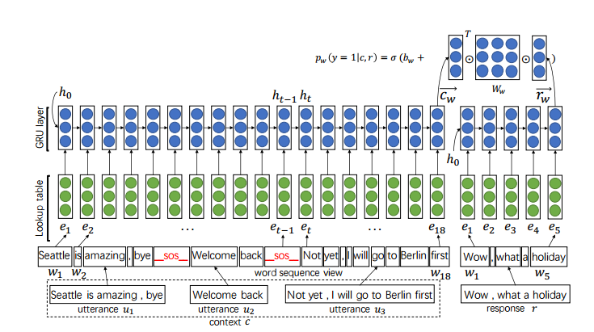
Existing Methods
LSTM (Lowe et al. 2015)

Slide 8
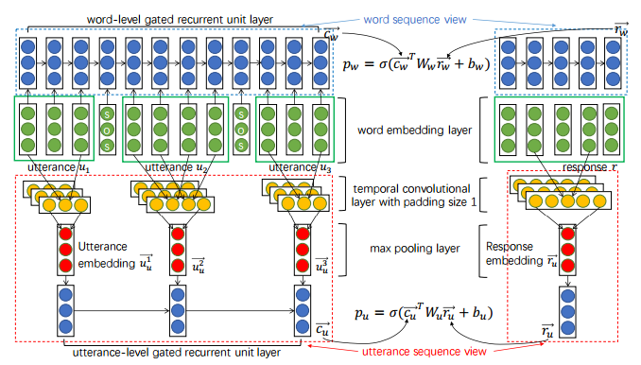
Existing Methods
Multi-View LSTM (Zhou et al. 2016)

Slide 9
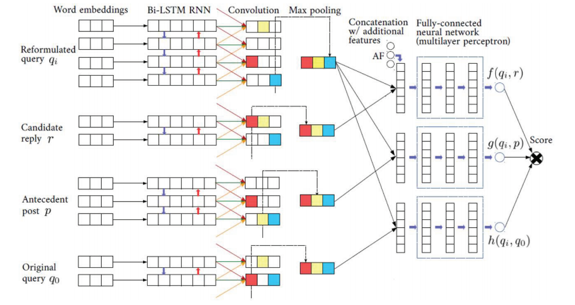
Existing Methods
DL2R (Yan et al. 2016)

Slide 10
Existing Methods
Important Imformation may lose
in the contextual representations

Slide 11
Key Idea
Utterances and response get connection before context representation.
Utterance relationship should be modeled under the supervision of response.
Avoid information lose
Directly model the relationship between matching vectors
Notes:
We propose a generative model to describe how questions and answers are created in CQA archives. Before formalizing the generative process, let us first imagine how askers, answerers, and other users interact on CQA archives. In a common case, askers have some topics on their minds and follow them to write their questions. Answerers see the questions, understand the topics of askers and follow the topics to give their answers. Finally, other users review questions and answers, and show their evaluations based on how they feel the answers fulfill needs in the questions. The evaluations usually reflect answer quality.

Slide 12
Contribution
(1) the proposal of a new context based matching model for multi-turn response selection in retrieval-based chatbots;
(2) the publication of a large human-labeled data set to research communities;
Notes:
We propose a generative model to describe how questions and answers are created in CQA archives. Before formalizing the generative process, let us first imagine how askers, answerers, and other users interact on CQA archives. In a common case, askers have some topics on their minds and follow them to write their questions. Answerers see the questions, understand the topics of askers and follow the topics to give their answers. Finally, other users review questions and answers, and show their evaluations based on how they feel the answers fulfill needs in the questions. The evaluations usually reflect answer quality.

Slide 13
Outline
Task, challenge, idea, and contribution
Our approach
Sequential Matching Network
Experiment
Experiment setup: data sets and baseline methods
Evaluation and analysis

Slide 14
Sequential Matching Network

Slide 15

Layer 1 (Utterance Response Matching)
(1)We construct two similarity matrices at the first layer. The first similarity matrix models utterance and response on a word level. Specifically, $∀i,j$ the $(i,j)$-th element of $M_{1}$ is defined by
$$e_{1,i,j}=e_{u,i}^{T} e_{r,j}$$
Where $e_{u,i}^{T} and e_{r,j}$ are word embeddings of utterance and response respectively.
(2)To construct $M_{2}$ we first use GRU to transform utterances and responses to hidden vectors, and then $∀i, j$ the $\left(i,j\right)$-th element is defined by
$e_{2,i,j}=h_{u,i}^{T}A h_{r,j}$
Where A is a parameter and $h_{u,i}^{T}, h_{r,j}$ are hidden vectors.
(3)After we construct similarity matrices, we employ CNN to extract similarity vectors.

Slide 16
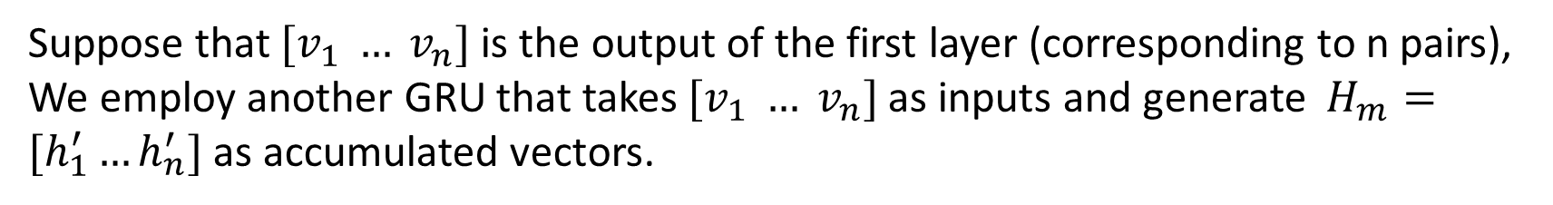
Layer 2 ( Matching Accumulation)
Suppose that $[v_{1} … v_{n}]$is the output of the first layer (corresponding to n pairs), We employ another GRU that takes $[v_{1} … v_{n}]$as inputs and generate $H_{m}=[h_{1}^{′}…h_{n}^{′}]$ as accumulated vectors.

Slide 17

Layer 3 ( Matching Prediction)
$${SMN}_{last}$$
We use the last hidden state $h_{n}^{′}$ to predict the matching degree.
$${SMN}_{static}$$
The hidden states are linearly combined. Then $L\left[h_{1}^{′}…h_{n}^{′}\right]=\sum_{i=1}^{n}{w_{i}h_{i}′}$. This equation indicates that the importance of each hidden state is only determined by its position.
$${SMN}_{dynamic}$$
We employ an attention mechanism to combine the hidden states.
$$t_{i}=tanh⁡(W_{1,1}h_{u_{1},n_{u}}+W_{1,2}h_{i}^{′}+b_{1})$$
$${ a}_{i}=\frac{t_{i}^{T}t_{s}}{\sum_{j}{exp⁡(t_{j}^{T}t_{s})}}$$
$$L\left[h_{1}^{′}…h_{n}^{′}\right]=\sum_{i=1}^{n}{a_{i}h_{i}′}$$
The importance of each utterance is determined by its representations.

Slide 18
Outline
Task, challenge, idea, and contribution
Our approach
Sequential Matching Network
Experiment
Experiment setup: data sets and baseline methods
Evaluation and analysis

Slide 19
Experiment Setup
Data set
Ubuntu Corpus (Lowe et al. 2015)
Conversations from an Ubuntu Forum.
 | train | val | test
context-response pairs | 1M | 0.5M | 0.5M
candidates per context | 2 | 2 | 10
Positive candidates per context | 1
Min turns per context | 3
Avg turns per context | 7.71
Avg words per context | 10.34

Slide 20
Experiment Setup
Data set (Chinese)
We have released a human annotated multi-turn conversation data set.
Open domain human-human conversations from Douban.
 | train | val | test
context-response pairs | 1M | 50k | 10k
candidates per context | 2 | 2 | 10
Positive candidates per context | 1 | 1 | 1.18
Min turns per context | 3 | 3 | 5
Max turns per context | 98 | 91 | 45
Avg turns per context | 6.69 | 6.75 | 6.45
Avg words per context | 18.56 | 18.50 | 20.74
data is available at https://github.com/MarkWuNLP/MultiTurnResponseSelection!!

Slide 21
Baseline Algorithms
Basic models: TF-IDF, RNN, CNN, LSTM, BiLSTM
MultiView: the model proposed by Zhou et al. that utilizes a hierarchical recurrent neural network to model utterance relationships.
Deep learning to respond (DL2R): the model proposed by Yan et al. that reformulates the message with other utterances in the context.
Advanced single-turn matching models: we concatenated the utterances in a context and matched the long text with a response candidate using more powerful models including MV-LSTM , Attentive-LSTM, and Multi-Channel which is described in our paper.
Notes:
Traditional LDA : question and all answers form one document

Slide 22
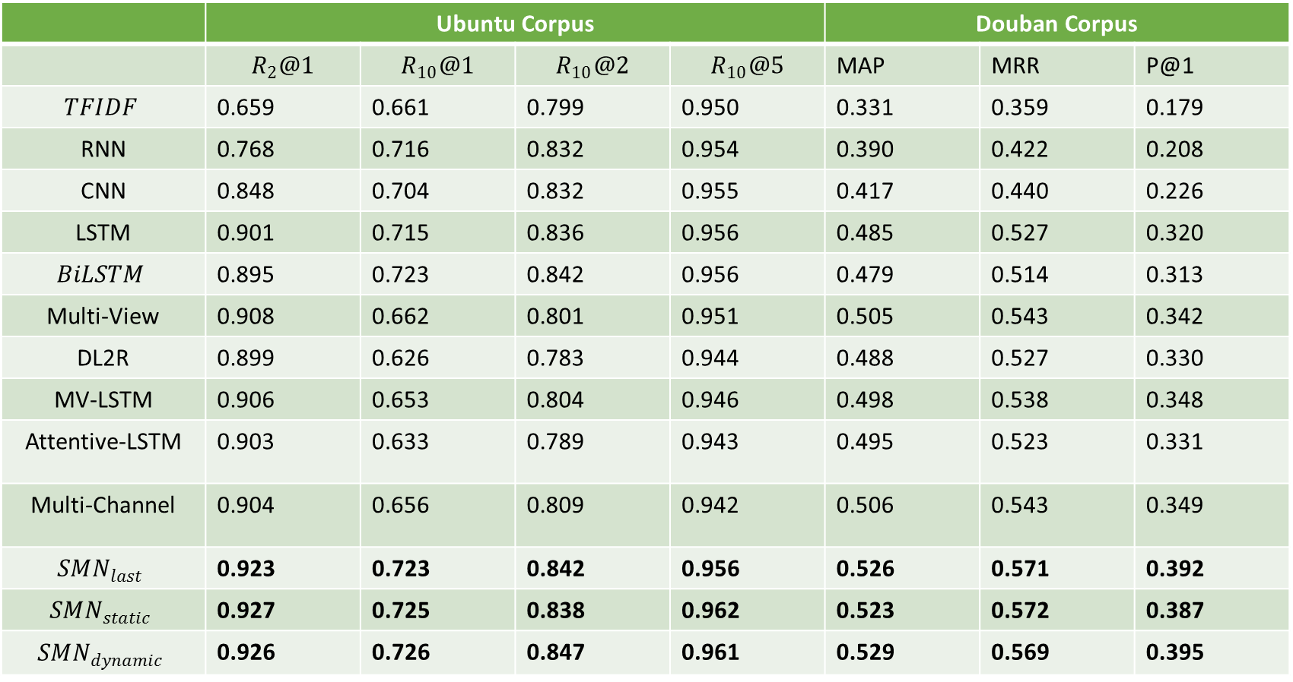
Quantitative Evaluation
 | Ubuntu Corpus |  |  |  | Douban Corpus
 |  |  |  |  | MAP | MRR | P@1
 | 0.659 | 0.661 | 0.799 | 0.950 | 0.331 | 0.359 | 0.179
RNN | 0.768 | 0.716 | 0.832 | 0.954 | 0.390 | 0.422 | 0.208
CNN | 0.848 | 0.704 | 0.832 | 0.955 | 0.417 | 0.440 | 0.226
LSTM | 0.901 | 0.715 | 0.836 | 0.956 | 0.485 | 0.527 | 0.320
 | 0.895 | 0.723 | 0.842 | 0.956 | 0.479 | 0.514 | 0.313
Multi-View | 0.908 | 0.662 | 0.801 | 0.951 | 0.505 | 0.543 | 0.342
DL2R | 0.899 | 0.626 | 0.783 | 0.944 | 0.488 | 0.527 | 0.330
MV-LSTM | 0.906 | 0.653 | 0.804 | 0.946 | 0.498 | 0.538 | 0.348
Attentive-LSTM | 0.903 | 0.633 | 0.789 | 0.943 | 0.495 | 0.523 | 0.331
Multi-Channel | 0.904 | 0.656 | 0.809 | 0.942 | 0.506 | 0.543 | 0.349
 | 0.923 | 0.723 | 0.842 | 0.956 | 0.526 | 0.571 | 0.392
 | 0.927 | 0.725 | 0.838 | 0.962 | 0.523 | 0.572 | 0.387
 | 0.926 | 0.726 | 0.847 | 0.961 | 0.529 | 0.569 | 0.395

Slide 23
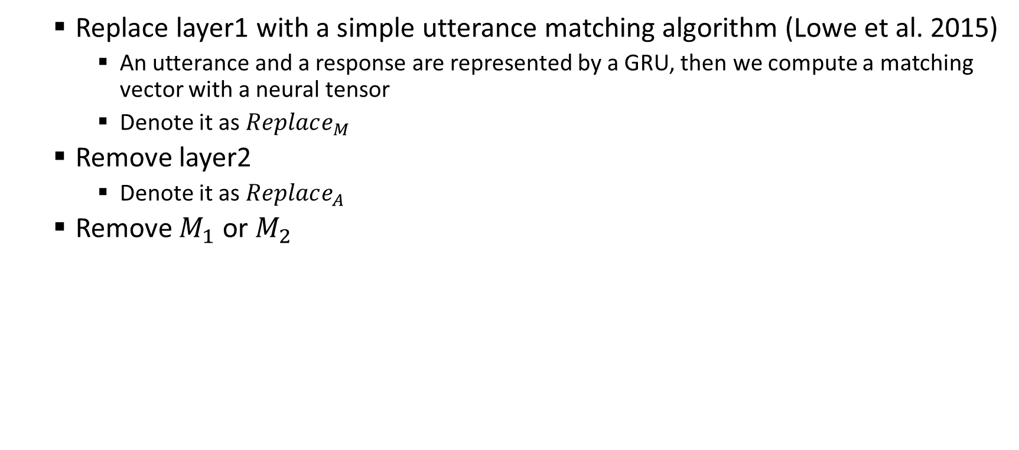
Ablation tests
Replace layer1 with a simple utterance matching algorithm (Lowe et al. 2015)
An utterance and a response are represented by a GRU, then we compute a matching vector with a neural tensor
Denote it as $Replace_{M}$
Remove layer2
Denote it as $Replace_{A}$
Remove $M_{1}$ or $M_{2}$

Slide 24
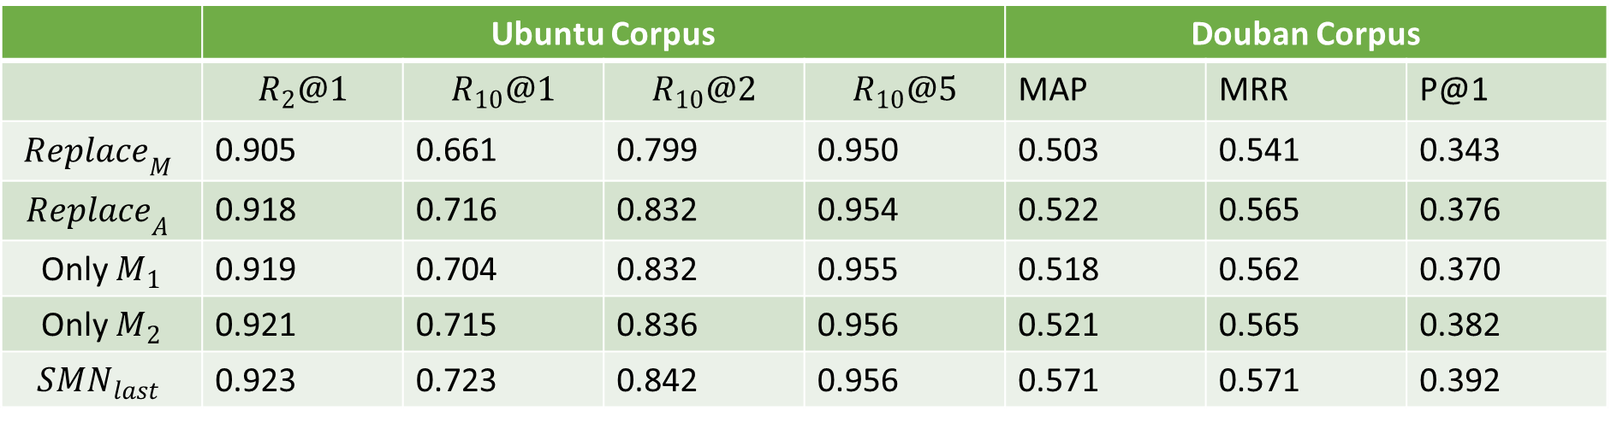
Ablation tests
 | Ubuntu Corpus |  |  |  | Douban Corpus
 |  |  |  |  | MAP | MRR | P@1
 | 0.905 | 0.661 | 0.799 | 0.950 | 0.503 | 0.541 | 0.343
 | 0.918 | 0.716 | 0.832 | 0.954 | 0.522 | 0.565 | 0.376
 | 0.919 | 0.704 | 0.832 | 0.955 | 0.518 | 0.562 | 0.370
 | 0.921 | 0.715 | 0.836 | 0.956 | 0.521 | 0.565 | 0.382
 | 0.923 | 0.723 | 0.842 | 0.956 | 0.571 | 0.571 | 0.392

Slide 25
Maximum context length
Ubuntu Corpus
Douban Corpus

Slide 26
Visualization
$M_{1}$ of different utterance response pairs

Slide 27
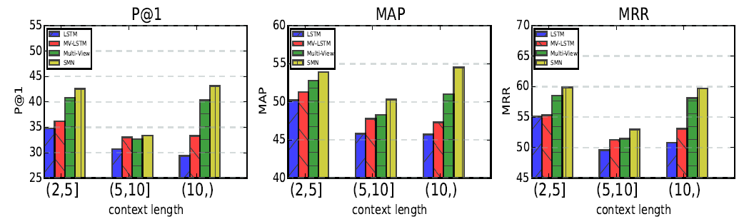
Comparison of LSTM, MVLSTM, Multi-View and SMN across context length

Slide 28
Error analysis
Logical consistency
In context “I do not like xxx”
In response “I love xxx”
No correct candidates after retrieval
Only 667 contexts have correct candidates after retrieval.

Slide 29
Conclusion
Study multi-turn response selection in retrieval-based chatbots.
Propose SMN for response selection
Utterances and responses get connection at first.
accumulate matching vectors instead of utterance vectors.
Release a human-labeled data set
Douban Conversation Corpus

Slide 30
THANKS!

